Slide 1
Activity Diagrams

Slide 2
Activity Diagrams
An activity diagram
Can be used to understand the flow of work that an object or component performs.
Can also be used to visualize the interrelation and interaction between different use cases.
Is most often associated with several classes.
One of the strengths of activity diagrams is the representation of concurrent activities.

Slide 3
Activity Diagram - Concurrency
Concurrency is shown using forks, joins and rendezvous, all three of which are represented as short lines, at which transitions can start and end.
A fork has one incoming transition and multiple outgoing transitions. The result is that execution splits into two concurrent threads.
A join has multiple incoming transitions and one outgoing transition. The outgoing transition will be taken only when all incoming transitions have been triggered.
A rendezvous has multiple incoming and multiple outgoing transitions. Once all the incoming transitions are triggered, the system takes all the outgoing transitions, each in a separate thread.

Slide 4
Activity Diagrams
An activity diagram also has two types of nodes for branching within a single thread. These are represented as small diamonds:
A decision node has one incoming transition and multiple outgoing transitions, each with a Boolean guard in square brackets. Exactly one of the outgoing transitions will be taken.
A merge node has two incoming transitions and one outgoing transition. It is used to bring together paths that had been split by decision nodes.

Slide 5
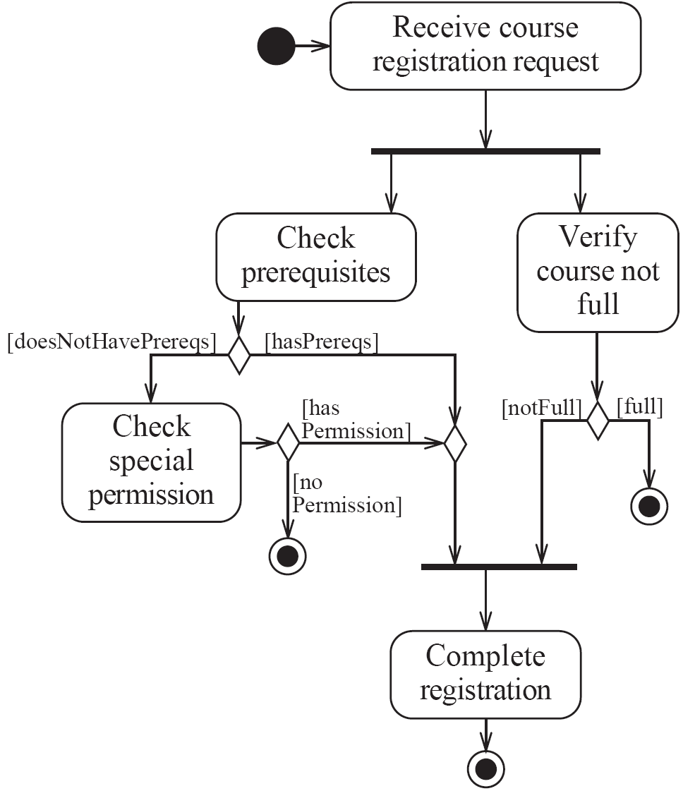
Activity diagrams – an example
The first thing that occurs is the reception of the registration request.
Once this processing is complete, the system immediately takes the outgoing transition and forks the processing into two concurrent threads.
The concurrent thread on the right is responsible for checking whether a course is full or not. The outcome of its computations is either that the course is not full, in which case execution proceeds to the join, or else the course is full, in which case the whole activity diagram terminates.
The concurrent thread on the left, meanwhile, checks whether the student is allowed to register. if this check is affirmative, the thread proceeds to the join via a merge node. Otherwise a second check is performed, to see if the student has special permission that can override the lack of prerequisites.
If this second check is affirmative, the thread proceeds to the join via the merge node, otherwise registration is disallowed and the whole activity diagram terminates.
if both threads reach the join, then they are replaced by a single thread that performs the final activity – completing the registration.

Slide 6
Swimlanes
Activity diagrams are most often associated with several classes.
The partition of activities among the existing classes can be explicitly shown using swimlanes.

Slide 7
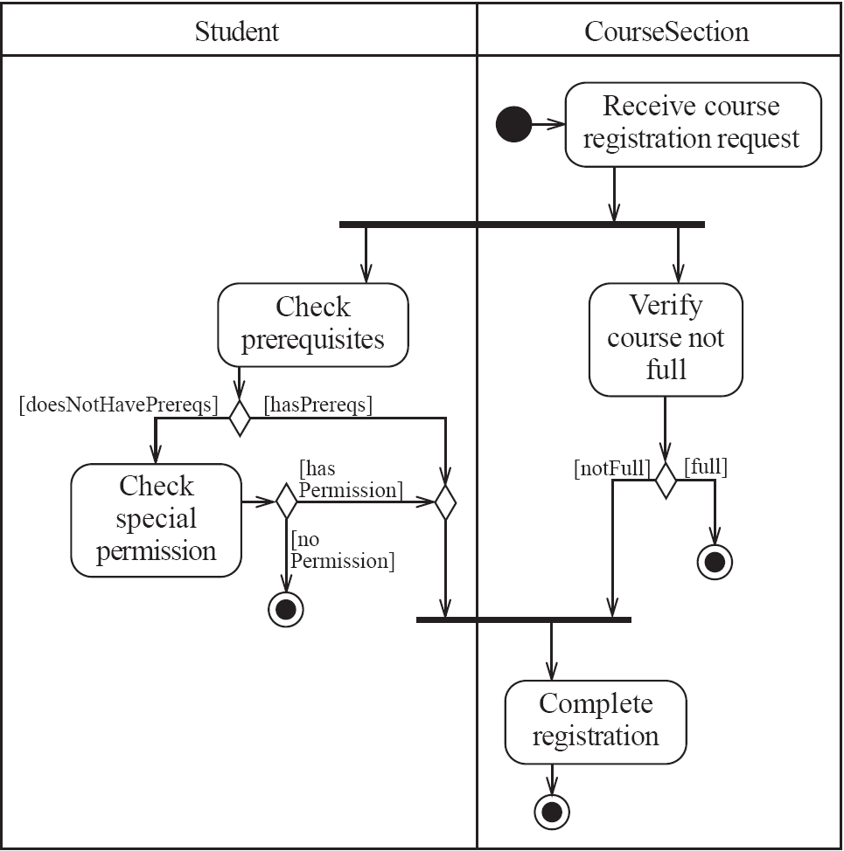
Activity diagrams – an example with swim lanes

Slide 8
Case Study 1
Draw an activity diagram representing each step of the process that shows various stages that passengers go through until they are seated in the airplane, buckled up, and the plane is ready to take off.
Once a passenger arrives at the check-in counter, he shows his ticket and his passport to the plane representative at the counter. The ticket is only verified then. Once the ticket is verified, the passenger is allowed to check in by first checking his luggage. In case the ticket is not verified, the passenger would be referred to customer services. Once he checks the luggage, the plane representative accepts his luggage. The representative then weighs the luggage and the passenger pays fee, if the luggage is overweight. The luggage is then submitted and the representative issues the boarding card and the passport is returned. After which the passenger enters lobby.

Slide 9
Case Study 2
Consider the following case study and Draw activity diagram for the following Room Booking system:
When customer requests a room, the hotel employee looks for room availability, then he inserts customer’s data and verifies if the provided credit card number has enough credit to pay the room: in this case the booking is confirmed and we wait customer arrival. The Hotel information system allows customer to modify or cancel his/her reservation. If customer arrives, he uses the room and then he pays, in case of no-show a penalty is accounted on his credit card and the booking is canceled.

